Slide 1
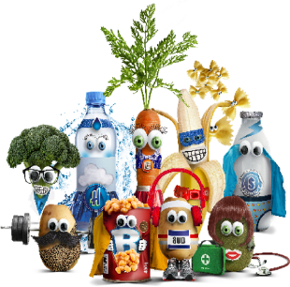
Primary Packed Lunch Menu
Week 1, 2 & 3
 | Monday | Tuesday | Wednesday | Thursday | Friday
Choice One | Ham Sandwich | Ham Sandwich | Ham Sandwich | Ham Sandwich | Ham Sandwich
Choice Two | Cheese Sandwich | Cheese Sandwich | Cheese Sandwich | Cheese Sandwich | Cheese Sandwich
Vegetables | Cucumber Sticks | Carrot Sticks | Cherry Tomatoes | Cucumber Sticks | Carrot Sticks
Fruit | Banana Or Mandarin Or Ice Cream
Drink | Water Bottle

